Slide 1
Opioid and Pain Management in Pharmacies Program (OPMPP)
Webinar
March 5, 2024
This research program is funded by the Ontario Health Mental Health and Addictions Centre for Excellence and has received ethics clearance through the University of Waterloo (REB #45514)
1
Notes:
Welcome, please save questions until the end for the Q&A period, you can put your questions in the chat box and we will address them at the end.

Slide 2
Meeting Agenda
Introduction
Research team
Why we developed the OPMPP
Goals of OPMPP
Flow of the research study
Recruiting & onboarding patients
Collecting consent
Eligibility
Patient Case: Mark
Sample case to illustrate OPMPP Process
Participant ID's
OPMPP Intervention
Initial Consult
PCP form
Patient satisfaction survey
Outcome measures survey
Follow-up
Pharmacist satisfaction survey
Important information
Accessing resources
Q&A session
Timeline of study
Submitting claims for renumeration

Slide 3


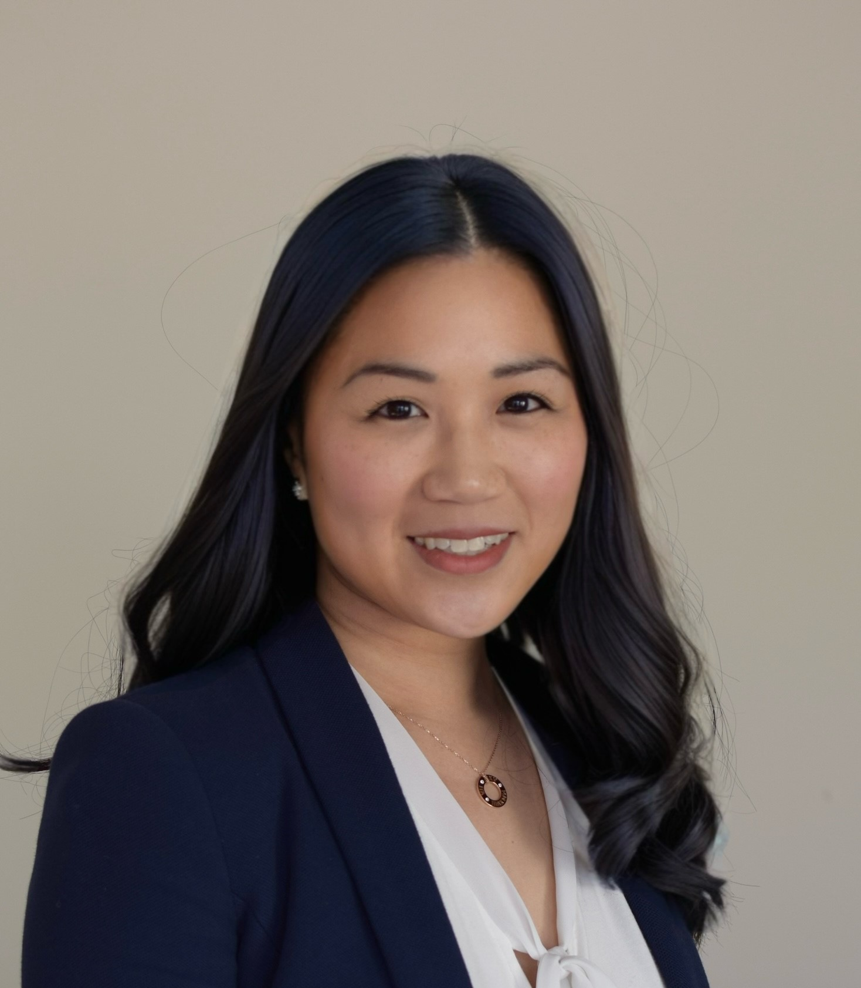


Introduction to the Research Team
Ashley Cid, Pharmacist Research and Practice, OPA
Angeline Ng, Vice President of Professional Affairs, OPA
Victoria Ip, Director of Professional Affairs, OPA
Feng Chang, Associate Professor, University of Waterloo

Slide 4
Why did we develop the OPMPP?
Health Canada reports 40,642 opioid-related deaths since Jan 2016
The role pharmacists play in addressing the prescription opioid crisis is valuable to reduce opioid-related harms
  Should be better leveraged in community setting
Opioid Stewardship is described as coordinated interventions designed to improve, monitor, and evaluate the use of opioids to support and protect human health.
In Ontario – no standard program or remuneration framework for opioid stewardship in community pharmacies
We are conducting the OPMPP to help mitigate impact of prescription opioid crisis and reduce patient progression to opioid use disorder

Slide 5
Goals of the OPMPP Research Study
The OPMPP targets patients with chronic non-cancer pain (CNCP) who are taking or starting a prescription opioid to help mitigate the impact of prescription opioids contributing to the opioid crisis
To support the appropriate prescribing and dispensing of opioids
To support the safe and appropriate use of opioids
To assess the feasibility and cost of providing the OPMPP to support potential broadscale implementation

Slide 6
Flow of the OPMPP Research Study
1. Recruit patients
10 per pharmacy over 6 months
2. Gather patient consent & determine patient eligibility
3. Complete initial consult
Determine if F/U is needed & book appointment
Complete PCP notification form if needed
4. Patient satisfaction survey
5. Outcome measures survey
6. Complete 1st or 2nd F/U if applicable
Book next F/U if applicable
Complete PCP notification form if needed
Repeat steps 4 & 5
7. Pharmacist satisfaction survey
Assign unique patient participant ID
Book initial consult
Completed by patient online or via paper version
Completed online
Completed at end of study period
Notes:
The goal is to recruit 10 patients per pharmacy and complete at a minimum an initial consult with each patient over a period of 6 months.
Follow-up consults would occur based on professional judgement.

Slide 7
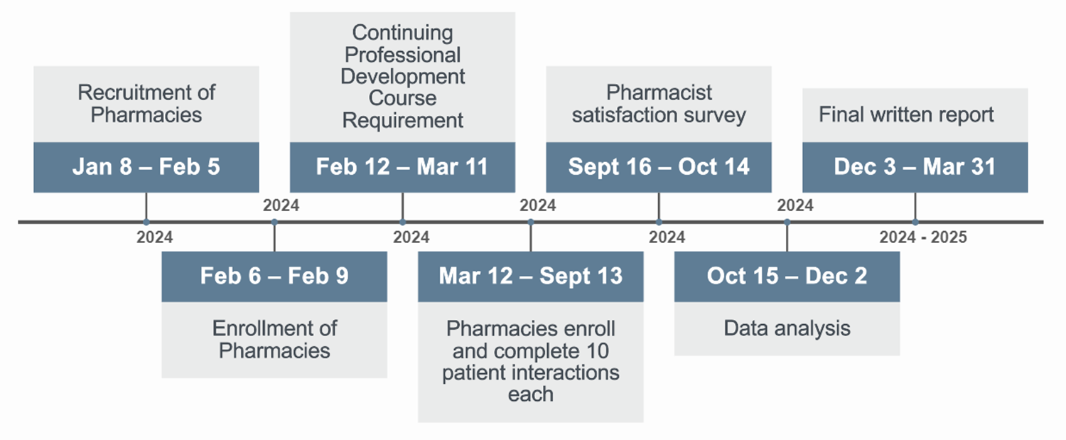
Timeline
26
Notes:
Reminders were sent out today to those who have not yet completed the CPD. Please aim to complete this ASAP by March 11. I will be reaching out to individual participants later this week for those who have still not yet made an account to complete the CPD.

Slide 8
Recruiting Patient Participants
Pharmacies can recruit patients through several methods
Passively:
  OPA has developed bag stuffers and a poster to use in your pharmacy
Actively:
  When dispensing an opioid prescription for CNCP
  When a BTC opioid is requested for CNCP
  When patients who have CNCP pick-up prescriptions
  Reviewing the pharmacy management system for patients on opioids for CNCP
Notes:
Targeting 10 patients per pharmacy but not every patient will choose to participate or be eligible so please start recruitment ASAP!

Slide 9
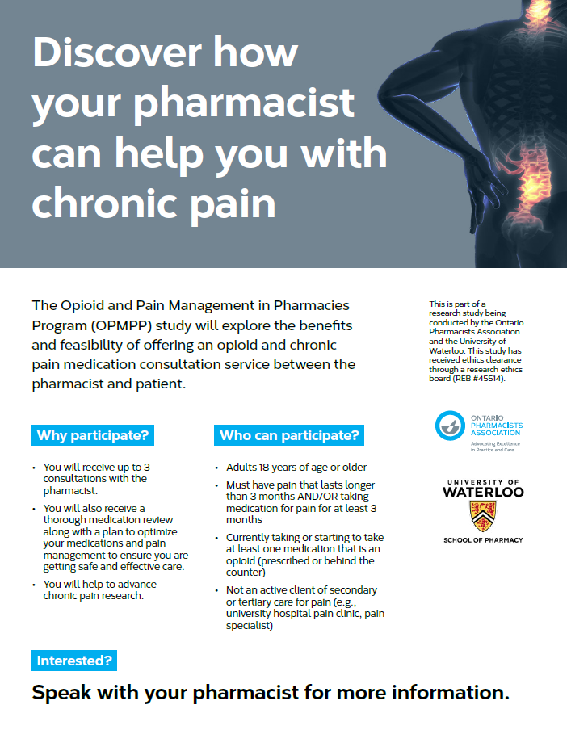
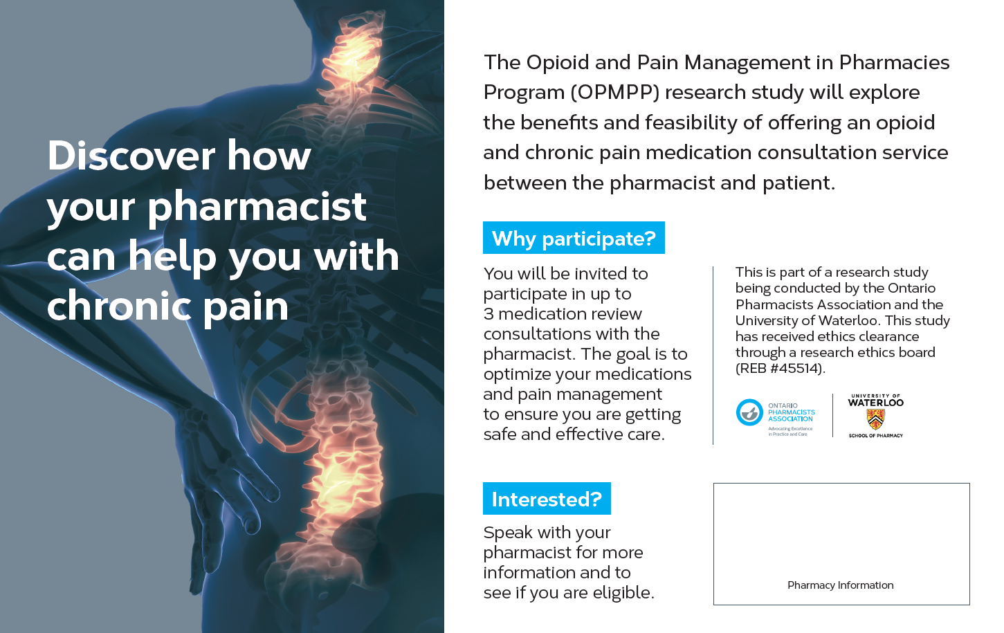
Recruiting Patient Participants
Pharmacy Poster
Bag Stuffer
Note: both resources are also available in black/white - printer friendly

Slide 10
Flow of the OPMPP Research Study
1. Recruit patients
10 per pharmacy over 6 months
2. Gather patient consent & determine patient eligibility
3. Complete initial consult
Determine if F/U is needed & book appointment
Complete PCP notification form if needed
4. Patient satisfaction survey
5. Outcome measures survey
6. Complete 1st or 2nd F/U if applicable
Book next F/U if applicable
Complete PCP notification form if needed
Repeat steps 4 & 5
7. Pharmacist satisfaction survey
Assign unique patient participant ID
Book initial consult
Completed by patient online or via paper version
Completed online
Completed at end of study period

Slide 11
Onboarding Patient Participants – Part 1
When you identify an interested patient, you must gather verbal consent first
Use the verbal consent script provided to read out the details of the study to the patient and provide the Patient Information Letter for the patient to read over
Ensure the patient is aware that their decision on whether to participate will not impact the care they receive from the pharmacy
When the patient is ready to provide verbal consent, if available, have a pharmacy team member or a family/friend of the patient witness the verbal consent occurring
If patients have questions about the study that you cannot answer from the script or information letter, please refer them to the research team: opmpp@opatoday.com or 1-877-341-0788
Notes:
As a reminder – this is different than publicly funded services you already currently offer. This is a research study that you are participating in so these next steps will be a bit different than your usual workflow but are important to follow.

Slide 12
Onboarding Patient Participants – Part 2
After a patient has provided verbal consent to participate, you must determine if they are eligible
Use the patient eligibility questionnaire to determine eligibility to participate
  Either you or the patient could fill this out
If not eligible for the study, or they do not consent to the OPMPP, the patient can be offered another service like a MedsCheck if they meet those eligibility requirements and would still like a medication review

Slide 13
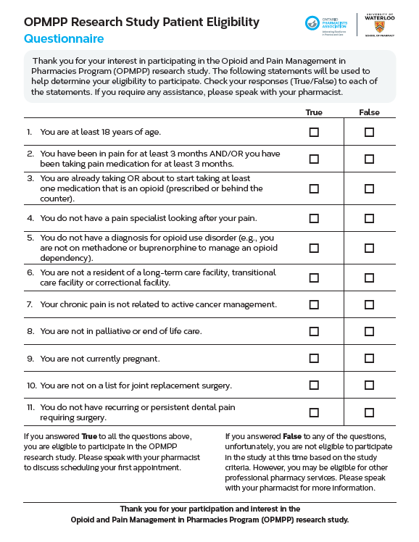
Patient Eligibility Questionnaire

Slide 14
Creating the Patient ID
Patient identifier should consist of
  Last 4 digits of the pharmacy phone number followed by a dash/hyphen and a numerical number to represent the patient
  E.g., if last four digits of pharmacy phone number is 1455, then the first participant for that pharmacy would be 1455-1, the second patient would be 1455-2 and so forth
The unique patient identifier must be used consistently for only that patient across any OPMPP service completed (i.e., initial consult and follow-ups)
The Participant ID Generator template can be used to track participant IDs for the pharmacy

Slide 15
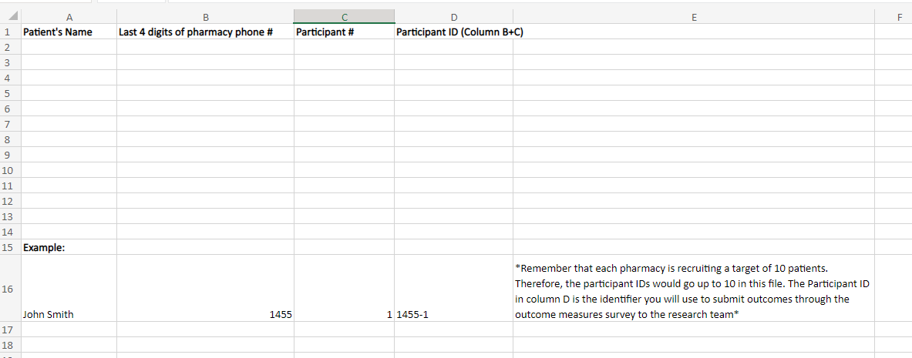
Creating the Patient ID
Password protect this file – to ensure it is only accessible by participating pharmacists.
Instructions on how to password protect excel file: https://support.microsoft.com/en-us/office/protect-an-excel-file-7359d4ae-7213-4ac2-b058-f75e9311b599

Slide 16
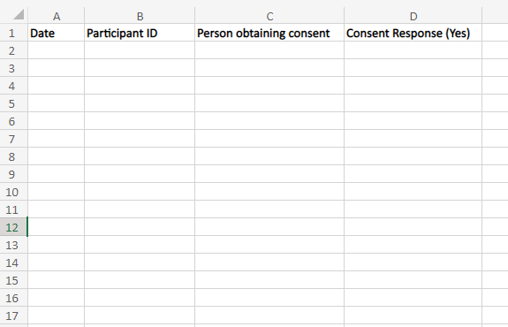
Verbal Consent Log
Password protect this file – to ensure it is only accessible by participating pharmacists. See instructions on previous slide
After you create the Participant ID, record that verbal consent was obtained in a consent log.
This will be shared with the research team at the end of the study period.
Notes:
Mention about documenting consent for the consults using worksheets or medscheck forms.

Slide 17
Booking the first patient consultation
After a patient has provided consent and is eligible to participate, can book the initial OPMPP consult
Recommend appointment-based model to help with pharmacy workflow
Appointments can occur in person at the pharmacy or virtually based on patient preference
Once an appointment is booked, keep track of the number of patients you have enrolled using the participant ID tracker and assign them their participant ID.

Slide 18
Patient Case: Mark
45-year-old cisgender male
Patient of the pharmacy for 5 years
Picking up a refill of oxycodone today with his wife
You inform him that your pharmacy is participating in the OPMPP research study and how it involves an opioid and chronic pain medication consultation
He is interested and wants to learn more – you read him the verbal consent script and hand him the study information letter to read
You have ensured him that his decision on whether to participate will not impact the care he receives from the pharmacy
He provides verbal consent with his wife as a witness
You review the study eligibility criteria with him and determine that he is eligible to participate
In your pharmacy’s Participant ID Generator document, you assign Mark his unique participant ID of 1955-5, since he is the 5th patient your pharmacy has recruited for the study
You document in your pharmacy’s Verbal Consent Log that verbal consent was obtained from Participant 1955-5
You book the initial consult with him to occur later that week at the pharmacy

Slide 19
Flow of the OPMPP Research Study
1. Recruit patients
10 per pharmacy over 6 months
2. Gather patient consent & determine patient eligibility
3. Complete initial consult
Determine if F/U is needed & book appointment
Complete PCP notification form if needed
4. Patient satisfaction survey
5. Outcome measures survey
6. Complete 1st or 2nd F/U if applicable
Book next F/U if applicable
Complete PCP notification form if needed
Repeat steps 4 & 5
7. Pharmacist satisfaction survey
Assign unique patient participant ID
Book initial consult
Completed by patient online or via paper version
Completed online
Completed at end of study period

Slide 20
OPMPP Initial Consult
OPA has developed worksheets to help you complete this process, but they are not mandatory to use
  If you plan on using other forms, e.g., MedsCheck forms, take note of what is required for reporting in the Outcome Measures Survey
Initial Consult involves:
  Medical history
  List of medications
  Morphine milligram equivalents calculation
  Assessment using the Routine Opioid Outcomes Monitoring (ROOM) tool
  Substance use history and screening using the Prescription Opioid Misuse Index (POMI) tool
  Goals of therapy
  DTP recommendations
  Patient education
  Action plan
  Follow-up plan

Slide 21
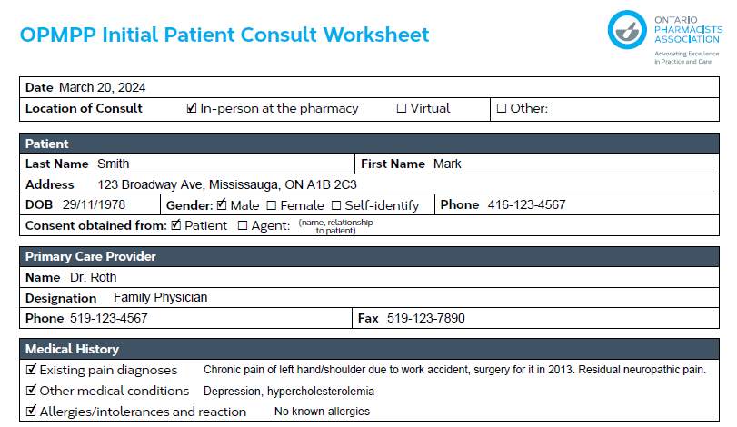
Patient Case: Mark
You complete the initial consult worksheet with Mark

Slide 22
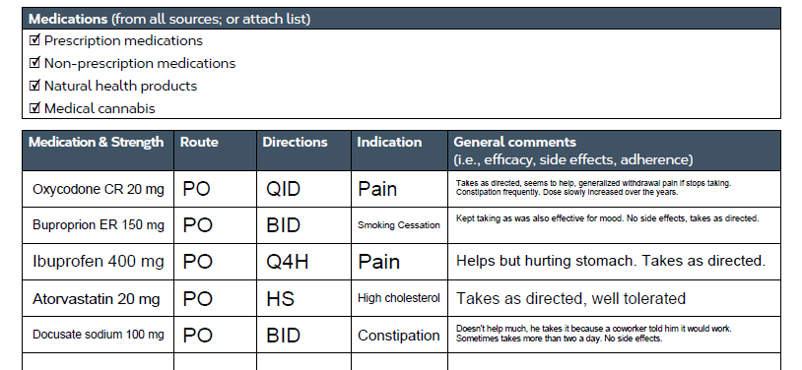
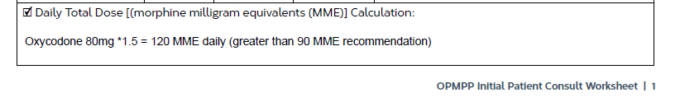
Patient Case: Mark

Slide 23
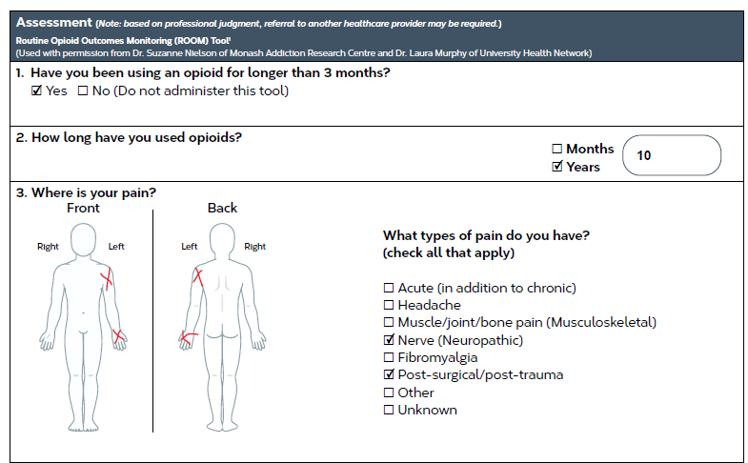
Patient Case: Mark

Slide 24
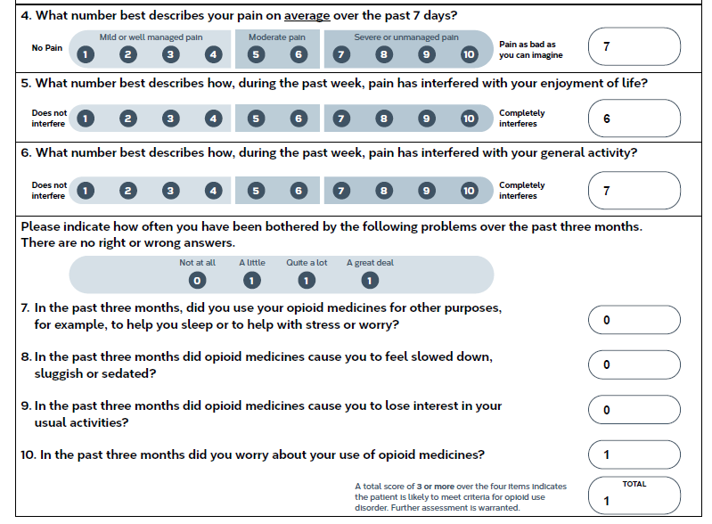
Patient Case: Mark

Slide 25
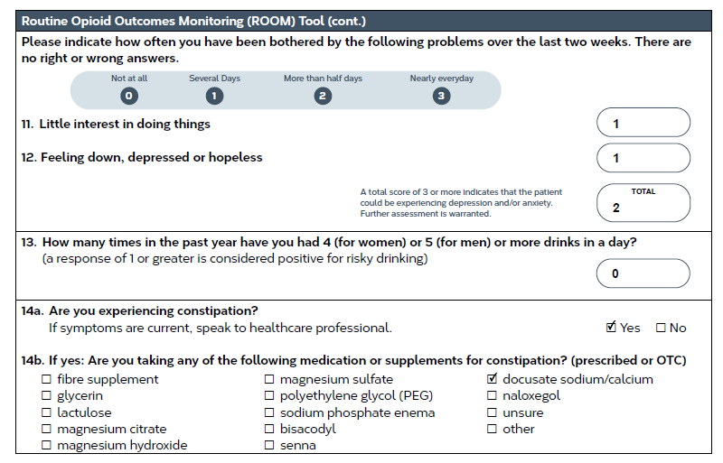
Patient Case: Mark

Slide 26
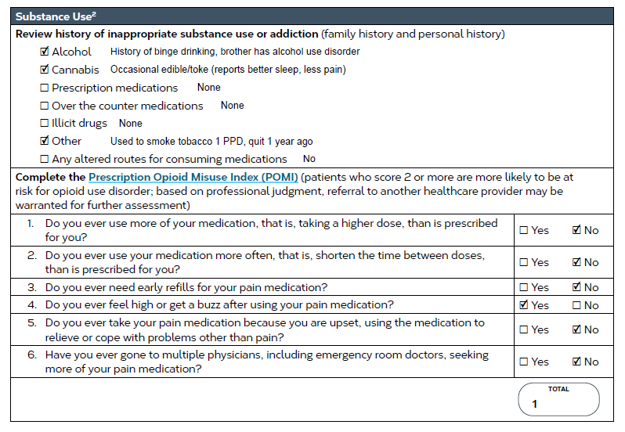
Patient Case: Mark

Slide 27
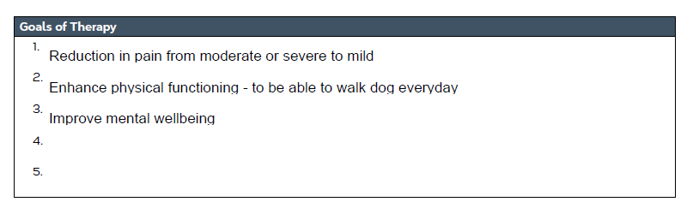
Patient Case: Mark

Slide 28
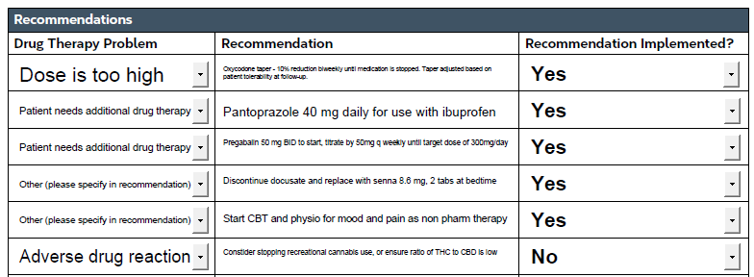
Patient Case: Mark
Notes:
Note – that this is filled out when the prescriber replies or a patient declines a recommendation.

Slide 29
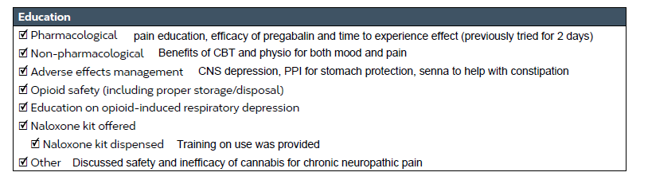
Patient Case: Mark

Slide 30
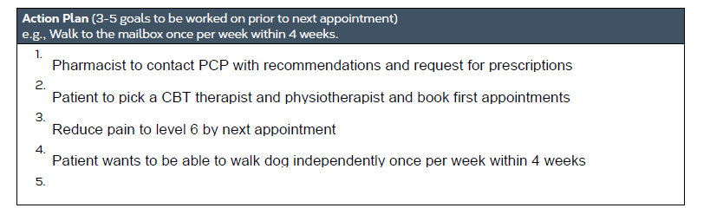
Patient Case: Mark

Slide 31
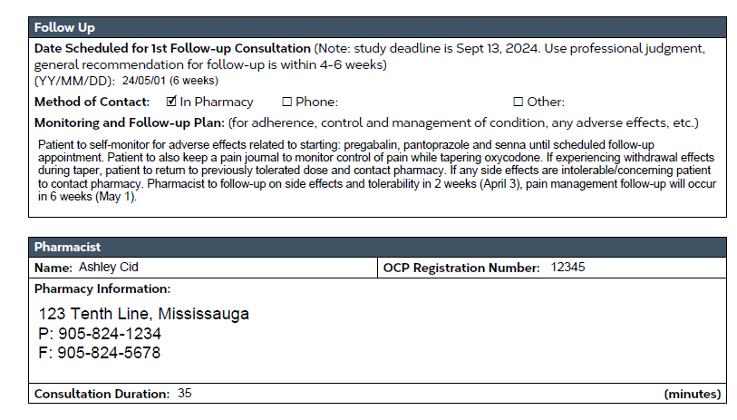
Patient Case: Mark
Notes:
Note – that this doesn't replace normal care process to check in with the patient about adverse effects, tolerability etc. You still follow-up on those as usual outside of the OPMPP follow-up. Then the OPMPP follow-up is to reassess overal pain management.

Slide 32
OPMPP Primary Care Provider Notification
If you need to communicate with the patient’s primary care provider after completing either the initial consult or any of the follow-ups, the Primary Care Provider Notification Form can be used
  One-page fillable PDF form

Slide 33
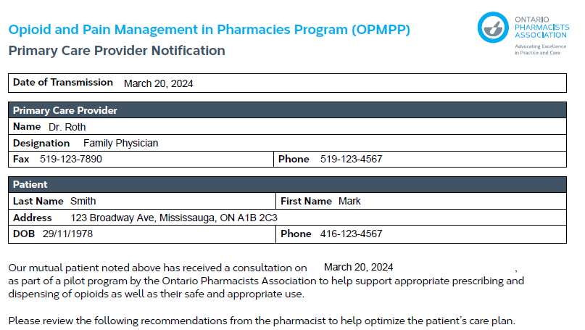
Patient Case: Mark
Notes:
Just a reminder that if any of your recommendations qualify for a POP and the patient is eligible for a POP, you can also bill those.

Slide 34
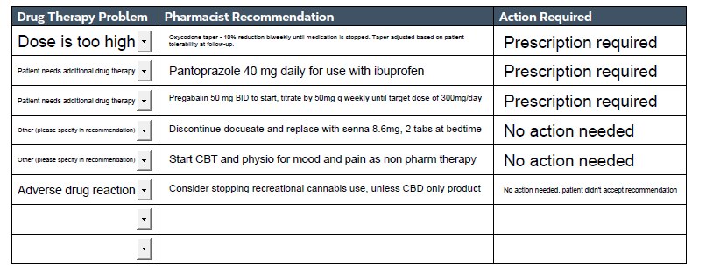
Patient Case: Mark

Slide 35
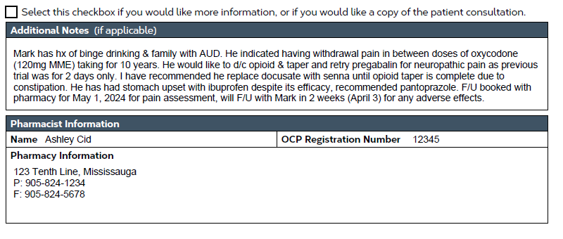
Patient Case: Mark

Slide 36
Flow of the OPMPP Research Study
1. Recruit patients
10 per pharmacy over 6 months
2. Gather patient consent & determine patient eligibility
3. Complete initial consult
Determine if F/U is needed & book appointment
Complete PCP notification form if needed
4. Patient satisfaction survey
5. Outcome measures survey
6. Complete 1st or 2nd F/U if applicable
Book next F/U if applicable
Complete PCP notification form if needed
Repeat steps 4 & 5
7. Pharmacist satisfaction survey
Assign unique patient participant ID
Book initial consult
Completed by patient online or via paper version
Completed online
Completed at end of study period

Slide 37
OPMPP Patient Satisfaction Survey
At the end of each OPMPP service (initial consult or follow-up) invite the patient to complete a 5-minute survey to share their satisfaction with the research team
Remind patients that you as the pharmacist will not know whether they completed this survey or not and that the survey is anonymous
Survey can be accessed online through Qualtrics via link or QR code – will be accessible via OPMPP website and e-mailed to all pharmacists
  Suggest printing out the QR code so that patients can easily scan it
If patient prefers a paper version, there is one available on the OPMPP website, print it out for the patient and provide a stamp so that they can mail it to the OPMPP research team
  More information later on about invoicing OPA for stamp

Slide 38
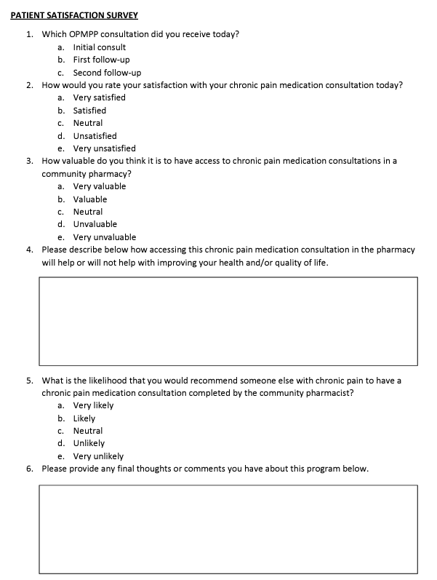
OPMPP Patient Satisfaction Survey
Sample of the paper version
Can be access via OPMPP website here:
https://www.opatoday.com/opmpp-study/#:~:text=Community%20pharmacists%20are%20well%20positioned,their%20safe%20and%20effective%20use.

Slide 39
Flow of the OPMPP Research Study
1. Recruit patients
10 per pharmacy over 6 months
2. Gather patient consent & determine patient eligibility
3. Complete initial consult
Determine if F/U is needed & book appointment
Complete PCP notification form if needed
4. Patient satisfaction survey
5. Outcome measures survey
6. Complete 1st or 2nd F/U if applicable
Book next F/U if applicable
Complete PCP notification form if needed
Repeat steps 4 & 5
7. Pharmacist satisfaction survey
Assign unique patient participant ID
Book initial consult
Completed by patient online or via paper version
Completed online
Completed at end of study period

Slide 40
OPMPP Outcome Measures Survey
Online survey to be completed after each OPMPP service (initial consult or follow-up)
  Takes 5 minutes to complete
  Uses parameters from the worksheets for reporting research outcomes (e.g., time to complete consult, categories of DTPs identified, resolution of DTPs, categories of education provided, etc.)
  Should wait until after hearing back from the prescriber if recommendations were made to complete this survey
Note: The completed OPMPP consult worksheets and any patient health information should not be shared with the research team.

Slide 41
OPMPP Outcome Measures Survey
Mandatory information to include:
  Last 4 digits of pharmacy phone number
  Patient identifier
  Type of OPMPP service completed (i.e., initial consult, 1st follow-up, 2nd follow-up)
  Study outcomes measures (refer to your worksheet or consultation notes)
The outcome measures survey must be completed to receive the professional service fee
  More information to follow about invoicing for the fee

Slide 42
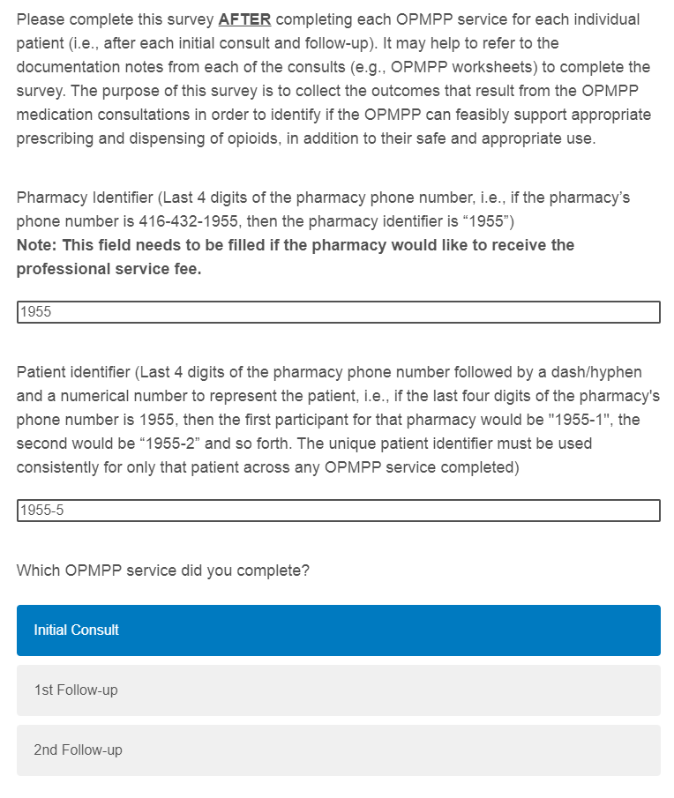
Patient Case: Mark

Slide 43
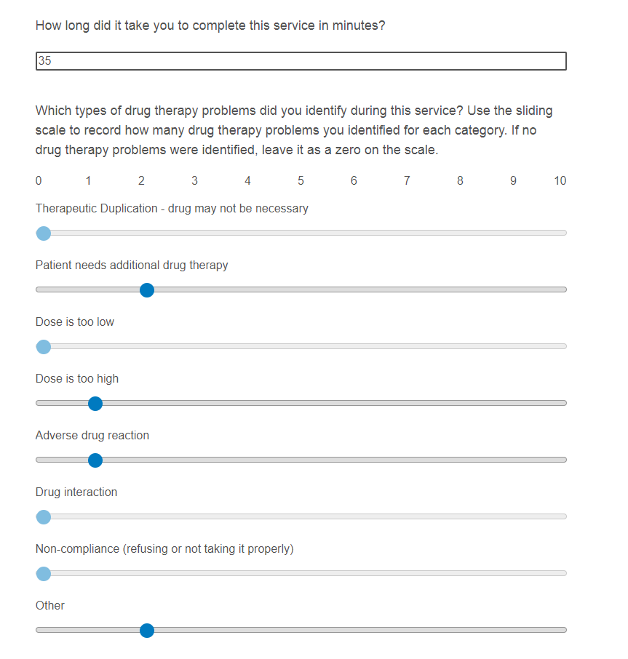
Patient Case: Mark

Slide 44
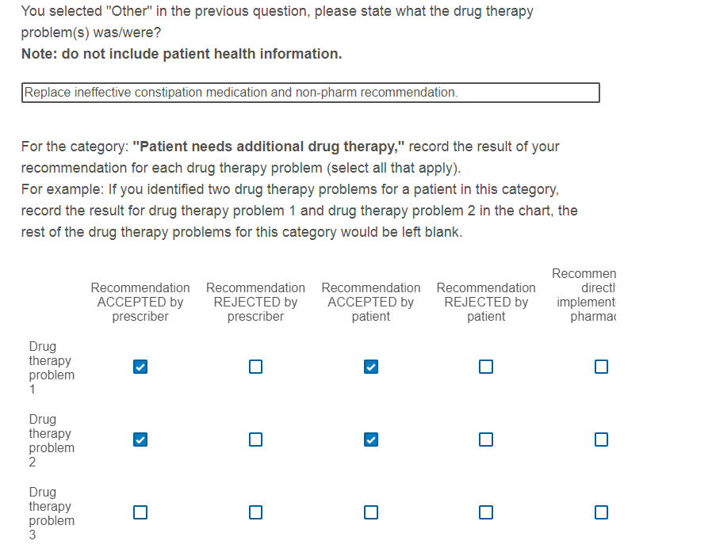
Patient Case: Mark

Slide 45
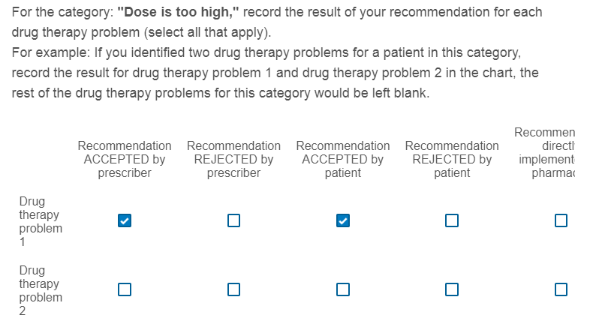
Patient Case: Mark

Slide 46
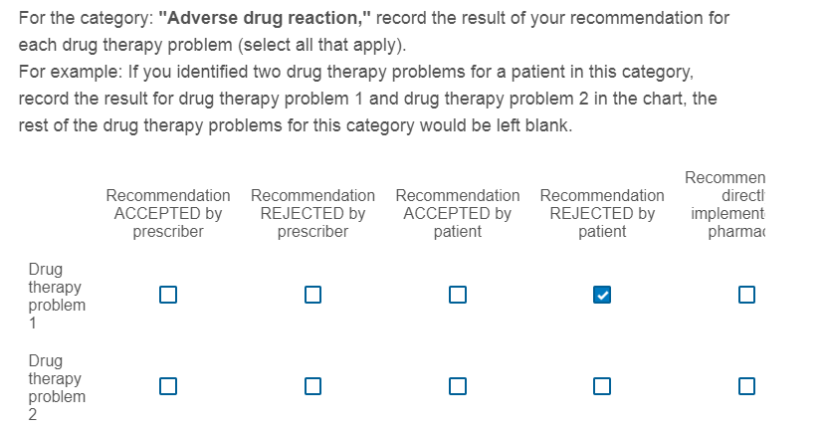
Patient Case: Mark

Slide 47
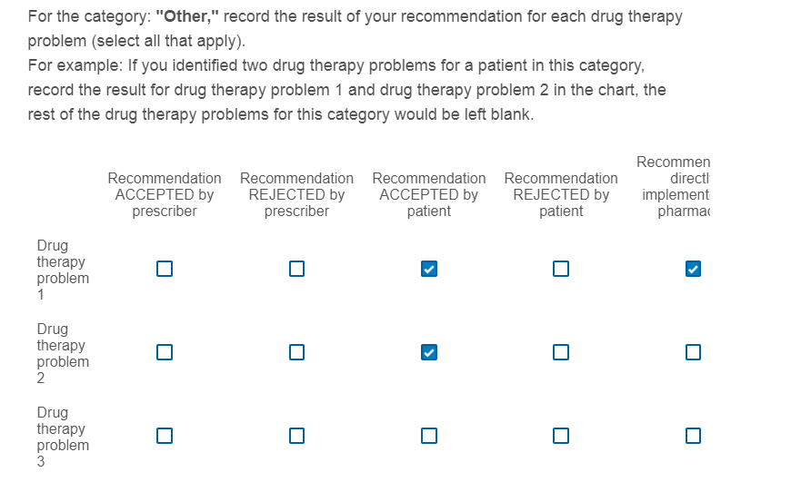
Patient Case: Mark

Slide 48
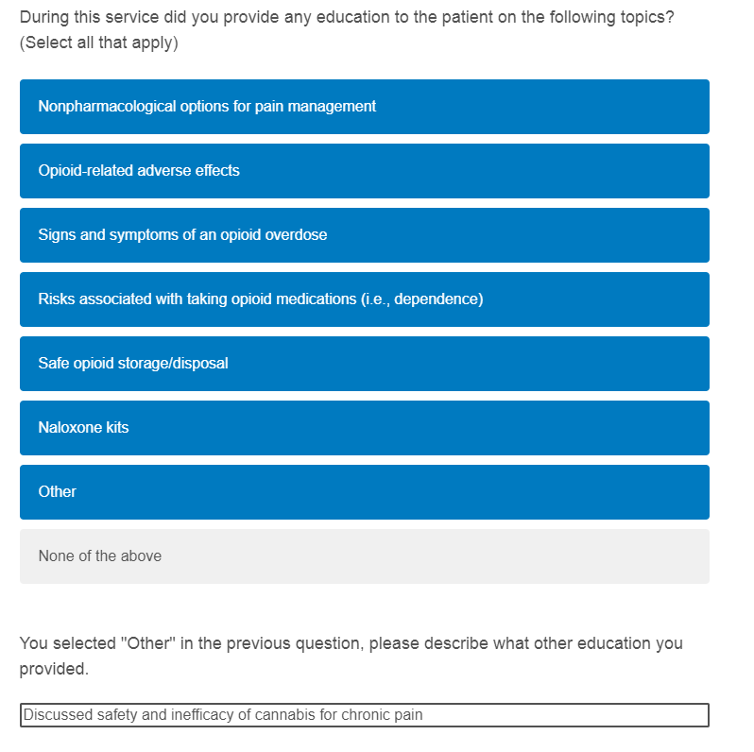
Patient Case: Mark

Slide 49
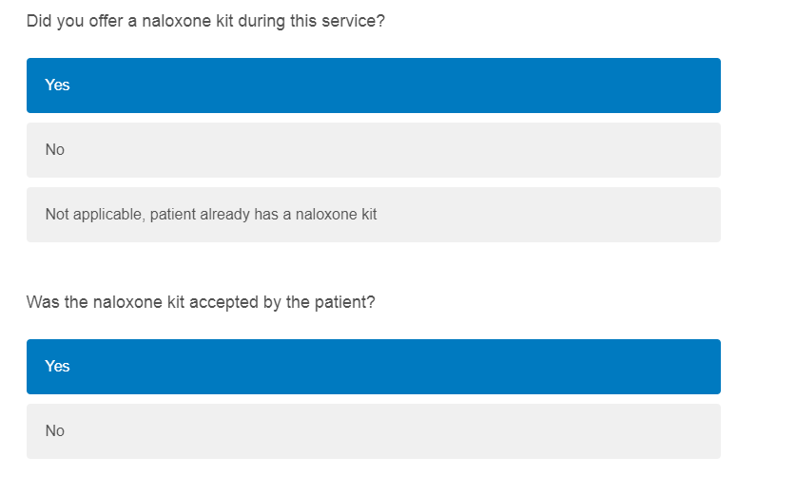
Patient Case: Mark

Slide 50
Flow of the OPMPP Research Study
1. Recruit patients
10 per pharmacy over 6 months
2. Gather patient consent & determine patient eligibility
3. Complete initial consult
Determine if F/U is needed & book appointment
Complete PCP notification form if needed
4. Patient satisfaction survey
5. Outcome measures survey
6. Complete 1st or 2nd F/U if applicable
Book next F/U if applicable
Complete PCP notification form if needed
Repeat steps 4 & 5
7. Pharmacist satisfaction survey
Assign unique patient participant ID
Book initial consult
Completed by patient online or via paper version
Completed online
Completed at end of study period

Slide 51
OPMPP Follow-up Consultations
Up to 2 follow-up consultations will be funded
Follow-up consults should occur based on professional judgement
General recommendation for follow-up timelines are 4-6 weeks from the initial consult or previous follow-up
  Use professional judgement if you think a follow-up should occur earlier or later than the suggested timeframe
Notes:
As a reminder you have 6 months to complete your assessments with 10 patients. Any consultations including initial consult and any follow-ups NEED to be completed within the study timeframe ie. You complete the consult and the outcome measures survey for funding. Therefore, important to get your initial consults in early on so that you have time to get your follow-ups completed.

Slide 52
OPMPP Follow-up Consultations
The follow-up consult worksheet can be used but is not mandatory
Follow-up worksheet involves:
  Changes to medical history
  New medications added/changed
  Assessment using the ROOM tool
  Changes in substance use and screening using the POMI tool
  Naloxone kit use
  DTP recommendations
  Patient education
  Action plan
  Follow-up plan

Slide 53
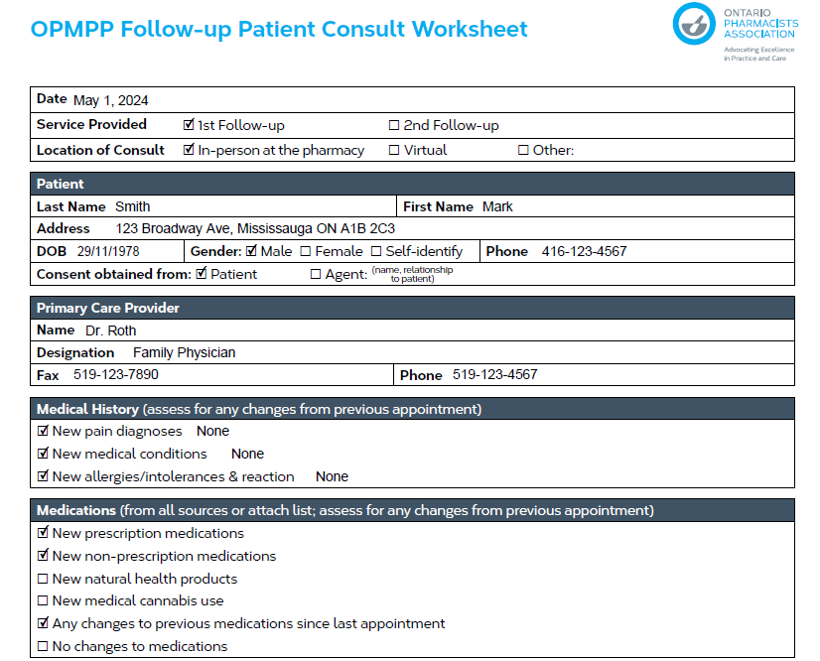
Patient Case: Mark
Notes:
Note: only one follow-up example is provided due to time constraints for this webinar, in real life would book a second follow-up and complete the same processes listed.

Slide 54
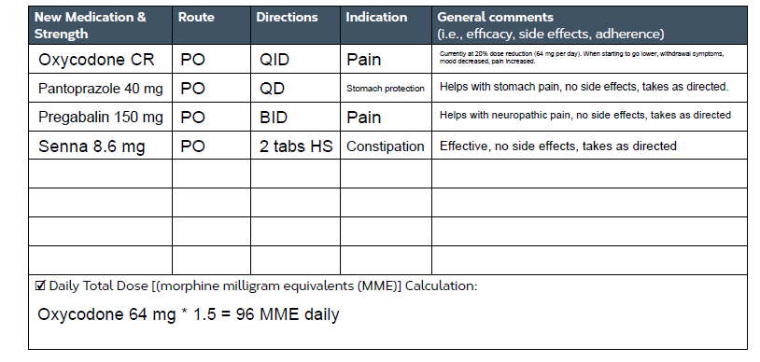
Patient Case: Mark

Slide 55
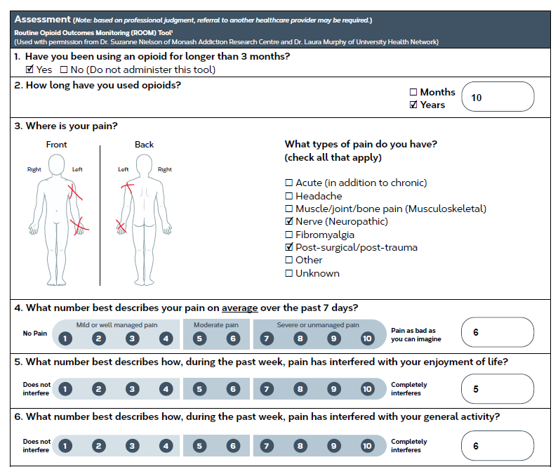
Patient Case: Mark

Slide 56
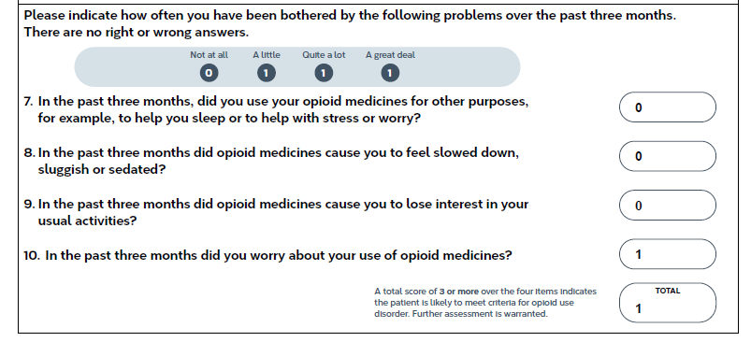
Patient Case: Mark

Slide 57
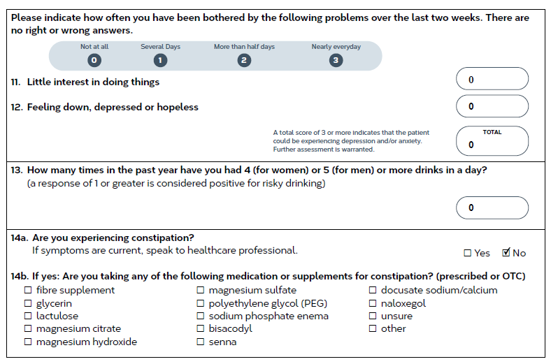
Patient Case: Mark

Slide 58
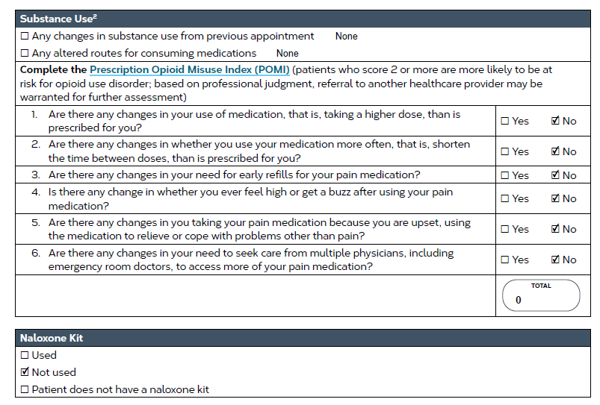
Patient Case: Mark

Slide 59
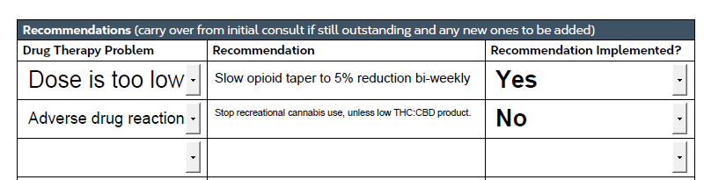
Patient Case: Mark
Notes:
Filled out after hearing from prescriber

Slide 60
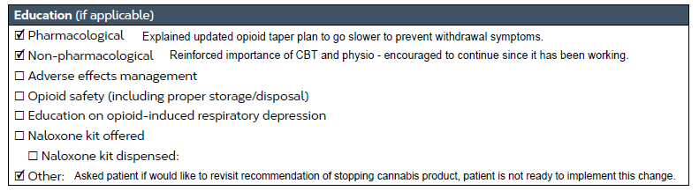
Patient Case: Mark

Slide 61
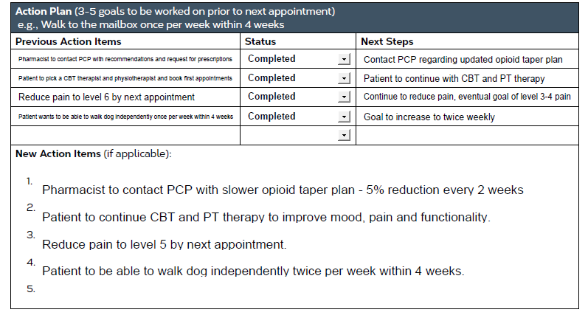
Patient Case: Mark

Slide 62
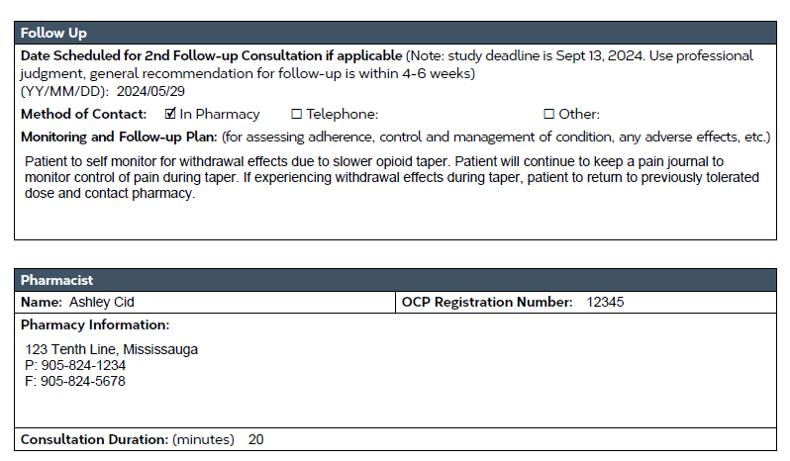
Patient Case: Mark

Slide 63
Flow of the OPMPP Research Study
1. Recruit patients
10 per pharmacy over 6 months
2. Gather patient consent & determine patient eligibility
3. Complete initial consult
Determine if F/U is needed & book appointment
Complete PCP notification form if needed
4. Patient satisfaction survey
5. Outcome measures survey
6. Complete 1st or 2nd F/U if applicable
Book next F/U if applicable
Complete PCP notification form if needed
Repeat steps 4 & 5
7. Pharmacist satisfaction survey
Assign unique patient participant ID
Book initial consult
Completed by patient online or via paper version
Completed online
Completed at end of study period

Slide 64
OPMPP Pharmacist Satisfaction Survey
Online survey to be completed at the end of the 6-month study period (starting Sept 16, 2024)
  Takes 5 minutes to complete
  Link will be emailed closer to the end date of the study
  Survey will close October 14, 2024
Completing this survey helps the research team understand how to improve the OPMPP for future widespread implementation

Slide 65
Professional Service Fees
Access the invoice template on the OPMPP website – an example is provided on website as well
Complete the pharmacy information fields and list each item out separately – include patient ID in each item
Include any fees incurred for providing a stamp/envelope to patients in the invoice template – provide original receipt for stamp/envelope only
At the end of the study period (Sept 13, 2024) e-mail an invoice for all completed professional services (initial consult and follow-up consult(s)) to opmpp@opatoday.com
Note that outcome measures surveys should be submitted as proof that the initial consult and follow-up consult(s) were completed.
Initial consult fee: $75 and Follow-up consult fee: $25 (up to 2 claims per patient)
26

Slide 66
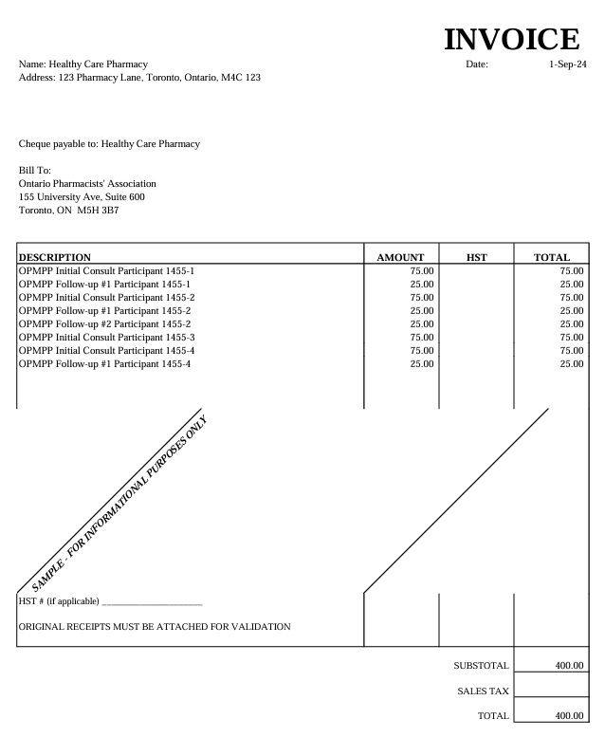
Professional Service Fees
26
Notes:
Mention that the payable to can be the company or a specified person, this is flexible for us.

Slide 67
Additional Information
All program materials (including a copy of the slide deck and recording of this webinar) along with other additional resources can be found on the OPMPP webpage: https://www.opatoday.com/opmpp-study/
If you have questions throughout the research study period, you can contact the research team by e-mail: opmpp@opatoday.com
We will also provide reminders via e-mail or phone throughout the study period to help make sure you stay on track
26

Slide 68
Thank You
On behalf of everyone on the OPMPP research team we would like to thank you for your participation and contribution to this research study.
26

Slide 69

Q&A Period
Please use the "raise hand" function or write in the chat box to ask a question
26

