Slide 1


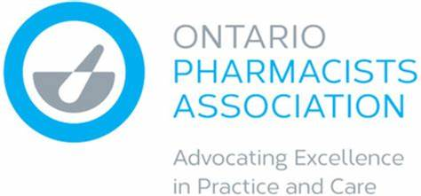
OPA Pharmacy
Store Insurance
Benefitting Members’ Bottom Lines
Across Ontario (and around the world) people are continuing to navigate the global COVID-19 pandemic. Pharmacists continue to play a critical role, providing COVID-19 testing and administering vaccines in addition to servicing their patients and customers.
The current Canadian insurance market continues to see double-digit increases on average (even for claims-free accounts), increased deductibles and reduced coverage. OPA is pleased to advise that the Pharmacy Store Insurance program has maintained broad form coverage for members throughout recent years, all while keeping consistent coverage conditions and ratings. Notably, there has been a significant growth in the program over the last 2 years, with many members bringing their pharmacies onboard.
While competitive terms and conditions are attracting members, it is the level of service from both the program’s servicing and claims team that have had pharmacies sticking with the program for 10+ years. OPA’s insurance broker, HUB International, has a dedicated group of customer service and claims professionals that have a comprehensive knowledge of the program, along with the pharmacy profession.

Slide 2

OPA Pharmacy Store Insurance Benefits | 2
The OPA Pharmacy Store Insurance program includes key coverages that are essential for pharmacy owners to protect their bottom line. The program provides all-risk property coverage, equipment breakdown coverage, crime, and liability coverage. In addition, the specially tailored OPA program also includes the following enhancements:
Entity professional liability coverage - $5,000,000 limit
Coverage to defend/protect the operating entity of the pharmacy, should it be named in a claim (most individual pharmacist professional liability policies exclude operating entities).
Consequential loss coverage
Stock damage as a result of equipment breakdown.
$5,000,000 general liability limit, which is being required by landlords and in contracts such as the Universal Influenza Immunization Program (UIIP).
In addition, the OPA Pharmacy Store Insurance program team at HUB have an in-depth knowledge of the privacy breach exposures that pharmacies face due to the increase in virtual care and the interconnection with various other healthcare servers (hospitals, LHINs, FHOs, etc.). HUB has experts that can walk pharmacy owners through these exposures and the various solutions to protect a pharmacy’s bottom line, to get your operation back up and running in the event of a privacy breach/cyber-attack.
Please contact the OPA HUB team at opa@hubinternational.com or call 855-672-7672 to discuss OPA benefits along with what privacy breach/cyber insurance options would suit your practice operation best.

